Slide 1
Chongqing University of Technology
ATAI
Advanced Technique of Artificial Intelligence
Chongqing University of Technology
Memory Augmented Graph Neural Networks for Sequential Recommendation
The Association for the Advance of Artificial Intelligence (AAAI-2020)
Reported by Ting Wang

Slide 2
Chongqing University of Technology
ATAI
Advanced Technique of Artificial Intelligence
Chongqing University of Technology
1.Introduction
2.Method
3.Experiments
4.Conclusion

Slide 3
Introduction
Challenge:
1. The hardness of modeling the short-term user interests
2. The difficulty of capturing the long-term user interests
3. The effective modeling of item co-occurrence patterns

Slide 4
Introduction
Innovation:
1. Use a memory augmented graph neural network to capture items’ short-term contextual information and long-range dependencies.
1. Use a memory augmented graph neural network to capture items’ short-term contextual information and long-range dependencies.
2. Use a gating mechanism within the GNN framework to adaptively combi ne these two kinds of hidden representations.
2. Use a gating mechanism within the GNN framework to adaptively combi ne these two kinds of hidden representations.
3. Use a bilinear function to capture the feature correlations between items.

Slide 5
Method
1.General user interest
2.User short-term interests
3.User long-term interests
4.Item co-occurrence patterns

Slide 6
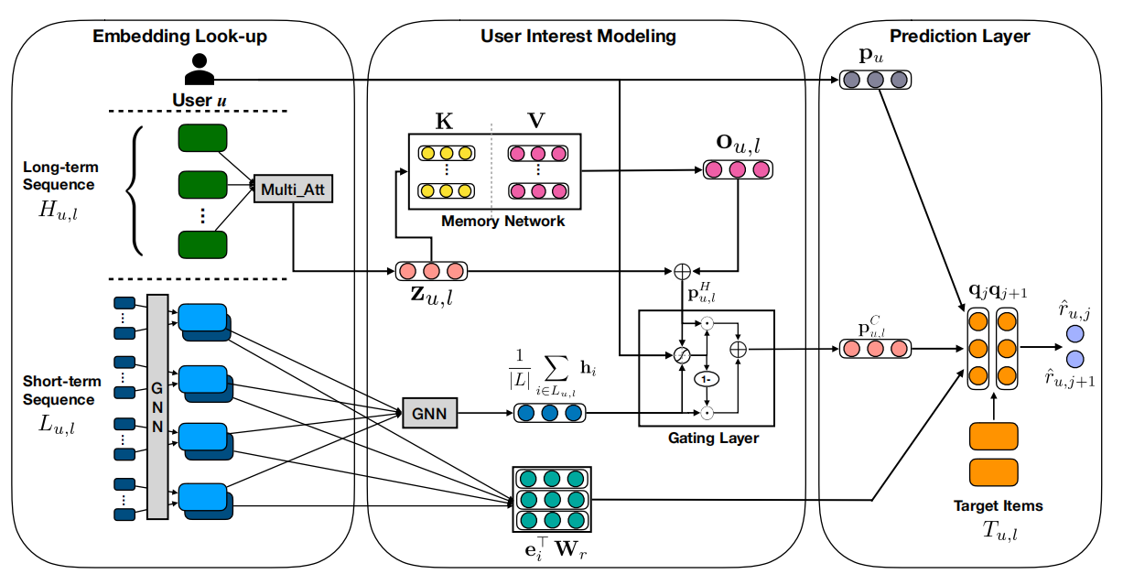
Method

Slide 7
Method
General user interest:
formula:
P_{u}: User embedding
q_{j}: output embedding of item j

Slide 8
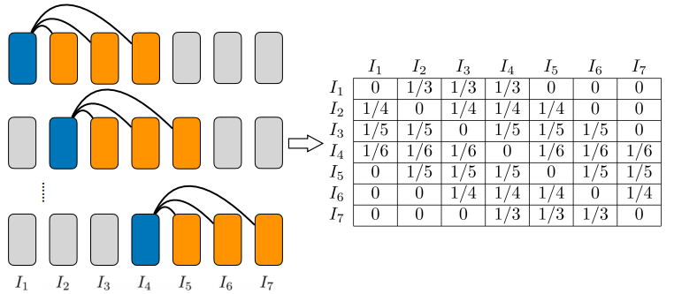
Method
User short-term interests:
Item Graph Construction
[.;.]: vertical concatenation
A: item adjacent matrix
e_{j}: input embedding of item j
p^{s}_{u,l}: a union-level summary
p_{u}: user embedding
formula:

Slide 9
Method
User long-term interests:
formula:
H_{u,l}: Item embedding
PE(·): sinusoidal positional encoding
⊗:outer product
S_{u,l}: attention score matrix
Z_{u,l}:query embedding
k_{i} ,v_{i}:the i-th memory unit

Slide 10
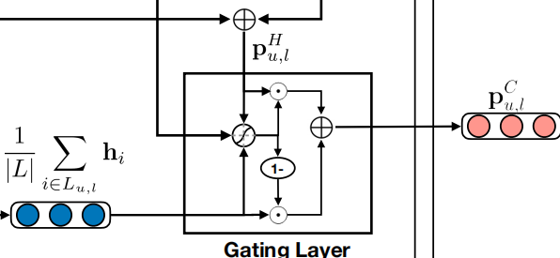
Method
Interest Fusion:
formula:
W⁽¹⁾_{g} ,W⁽²⁾_{g} ,W⁽³⁾_{g}: learnable parameters
g_{u,l}: learnable gate

Slide 11
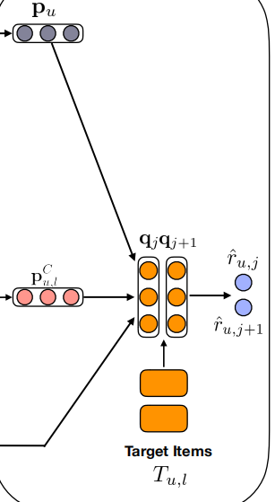
Method
Item co-occurrence patterns:
e_{i}: input embedding of item i
W_{r}: learnable parameter
q_{j}: output embedding of item j
formula:
Prediction:
formula:

Slide 12
Experiments
Evaluation results on Amazon-CDs, Amazon-Books,Goodreads Children,Goodreads-Comics and MovieLens-20Mdatasets.

Slide 13
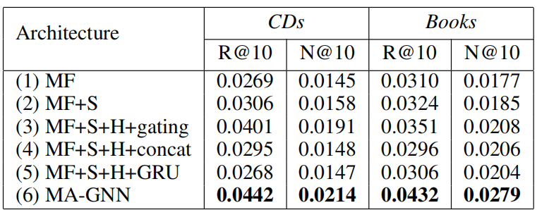
Experiments
The ablation analysis:
S: the short-term interest module H:the long-term interest module

Slide 14
Conclusion
Experimental results on five real-world datasets clearly validate the performance advantages of our model over many state-of-the-art methods and demonstrate the effectiveness of the proposed modules.

Slide 15
Thank you!

